Slide 1

Introduction to Git

Slide 2
Learning Outcomes
What is version control and Git, and why is it useful?
Setting up Git
Repositories
Committing your work
Branches
Merging your work
Merge conflicts
Pulling and pushing

Slide 3
Introduction – the why

Slide 4

Version Control
Tracking and maintaining a full history of changes on a local project which can be shared to collaborate (distributed version control). The system we’re focusing on is called Git.
Which changes were made?
Who made the changes?
When were the changes made?
Notification of when work conflicts occur.

Slide 5






Git
Project
files
changes
Project_Final
Project
.git
Version control handles all project files with a .git file to track every change.
Project_2021

Slide 6


Version Control - Remote
Maintaining a remote version of the project in a central server, accessible by all collaborators with tools to manage workflow.
GitHub
Gitea (secure, internally hosted option)

Slide 7


GitHub / Gitea
Project
.git
Notes:
Allows two or more analysts to easily work on the same project
An image shows a computer storage drive with a folder called project and a file called .git. There is a dotted circle around this and to arrows go out from the circle to two images representing analysts on working on a computer

Slide 8
Foundations – the what

Slide 9
A Concept Map
files
have
history
make
differences
contains
has many
consists of
records
branch
commit
log message
repository
may have
identifies
can merge with
creates
author
remote
Notes:
Note of alt text for this concept map
A repository may have a remote
A remote identifies a repository
A repository contains files
A repository has many branches
Files are in a branch
A branch can be merged to one or more times
A branch consists of one or more commits
An author creates one or more commits
Files have history
When code is committed a log message is recorded with the commit. Commits are records of differences in code.
The history of file is made up of a record of commits of differences to code

Slide 10





Basic Workflow
1
1+2=3
Main Branch
1+
1+2
1+2=4
1+2=3
Branch
Merge
Commits
Review and discuss
Pull Request
Notes:
Note of alt text for this basic workflow
Branches come off the main branch
An analyst or developer creates a branch from the main code base branch
A branch will usually have two or more commits of changes to code
A pull request is then raised, this will include information on the commits made so far
The pull request is reviewed and discussed
A further commit may happen after discussion
Once the commits in the pull request have been agreed the code is merged back into the main branch

Slide 11
Setup

Slide 12

Checklist
Access to Posit Workbench
GitHub account > added to PHS organisation
Check Posit Workbench setup and configure SSH key
Install Git (only needed if working on machine locally)

Slide 13
Repositories – the how

Slide 14

Repository (Repo)
A repo is the directory where project files are stored and is made of 2 parts:
user generated files/directories
.git directory
The .git file is located at the root of the repository, it stores all the information Git records, and should never be edited directly.
Project
.git

Slide 15
A Concept Map
files
contains
repository
repository
Notes:
Note of alt text for this concept map
A repository contains files

Slide 16
New Repo
You can start using Git at any stage in a project, the earlier the better. This will add the .git directory ready to start tracking work.
In RStudio:
New Project: Go to New Project > New Directory > New Project:
select ’Create a git repository’ during setup (leave new session box unchecked and RStudio will restart)
Existing Project: go to Tools > Project Options > Git/SVN:
select Git as the version control system.
$ git init

Slide 17
Does Git know who you are?
If you haven’t used Git in RStudio before you need to set information about who you are. This is done in the terminal and only needs to be completed once.
git config --global user.email <email address> [use your PHS email address here]
git config --global user.name <your name> [use your GitHub username here]

Slide 18
Cloning a Repo
Bringing a repo that is hosted elsewhere into a local folder on your computer.
In RStudio:
Go to New Project > Version Control > Git
enter URL details (leave new session box unchecked and RStudio will restart)
git clone <my repo url>

Slide 19

Activity
Go to GitHub repo: github.com/Public-Health-Scotland/learn-git
Explore contents of repo
Guided clone of repo
Open project in RStudio
Notes:
github.com/Public-Health-Scotland/learn-git

Slide 20
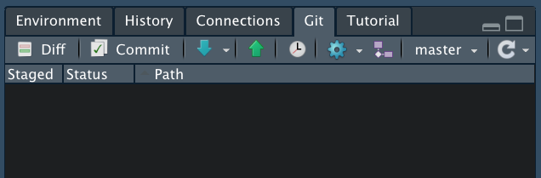
Status
This will display a list of files that have changed since the last commit.
As we’ve just cloned the repo, there are no changes to see… yet!
$ git status

Slide 21
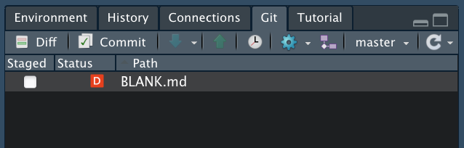
Change
While you work, Git is tracking. Any changes made will show as part of the Git status.
We’ve deleted the file called ‘BLANK.md’. The status shows this and lets us know it has been deleted (red D).
$ git status
Notes:
Blue M: Modified
Yellow ?: Untracked
Red D: Deleted Green A: Added
Pink R: Renamed

Slide 22
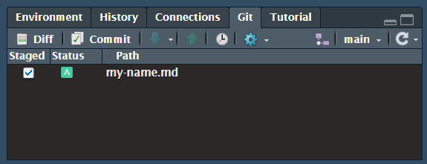
Stage
When we have made changes and want to build a commit (a snapshot of changes), we need to stage them using the checkboxes. This interface may need refreshed to see latest changes.
This is like putting together a parcel to send in the mail. You can freely add and remove things (changes), “building” your commit.
$ git add <filename>

Slide 23

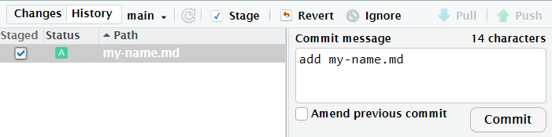
Commit
A commit takes everything that has been staged to generate a historical log of changes. You also add a meaningful message to identify changes and reasoning.
To continue the analogy, this is posting your parcel with a note. Once it’s sent, the parcel is gone, and you can’t change what’s inside.
$ git commit –m "<message>"

Slide 24
A Concept Map
files
contains
records
log message
repository
commit
repository
Notes:
Note of alt text for this concept map
A repository contains files
When code is committed a log message is recorded with the commit.

Slide 25
Exercise 1
Create a text file.
Add your name to the first line of the file.
Save the file as "<your_name>.md”
Stage and commit. Don’t forget your message.

Slide 26

Ignore
What about files we don’t want to track (data, configuration, logs, etc.)? Well, Git provides us with the .gitignore file.
This file can take exact strings for filenames and directories, or wildcard patterns. As such "build" and "*.pdf" will ignore directories (and anything in it) or files called ‘build’ and any PDF file.
.gitignore

Slide 27
Exercise 2
Create a CSV file with "<name>, <age>, <location>", saved as "<user_details>.csv".
Change the .gitignore to ignore all CSV files.
Stage and commit only the .gitignore changes.
Review the Git status.

Slide 28
History – the how

Slide 29
Hash
Every commit has a unique ID, called a hash, generated from the content of the commit. This is a long hexadecimal string, but when directly referencing, the first 6-8 characters will most certainly be enough.
If using command line, a special label, ‘HEAD’, is used to represent the last commit, ‘HEAD~1’ for the one before, ‘HEAD~2’ for the one before that…
fc75a7ce604a13357f050f0f8735da4c2396ef97
9521c18c0143a36a18553522bbeeb51ebc29ae41

Slide 30


Log
The log is Git’s history, it includes the hash, and details of who, when, and what.
All commits are shown in the log, this is an example of how one is displayed. RStudio’s interface is more friendly, click on the clock to explore this repo’s history.
$ git log
commit fc75a7ce604a13357f050f0f8735d
Author: Git Learner <learner@git.com>
Date: Mon Feb 01 13:31:26 2021 +0000
initial commit
Notes:
You can also restrict the output to a specific number of commits, e.g. ‘git log -2’ for the last two commits on the log. If you’re only interested in a specific file too, you can add that to the end, e.g. `git log -3 report.md` will show the last three commits on the log that affect `report.md`.

Slide 31
A Concept Map
files
have
history
contains
records
log message
repository
commit
repository
creates
author
Notes:
Note of alt text for this concept map
A repository contains files
An author creates one or more commits
Files have history
When code is committed a log message is recorded with the commit.

Slide 32
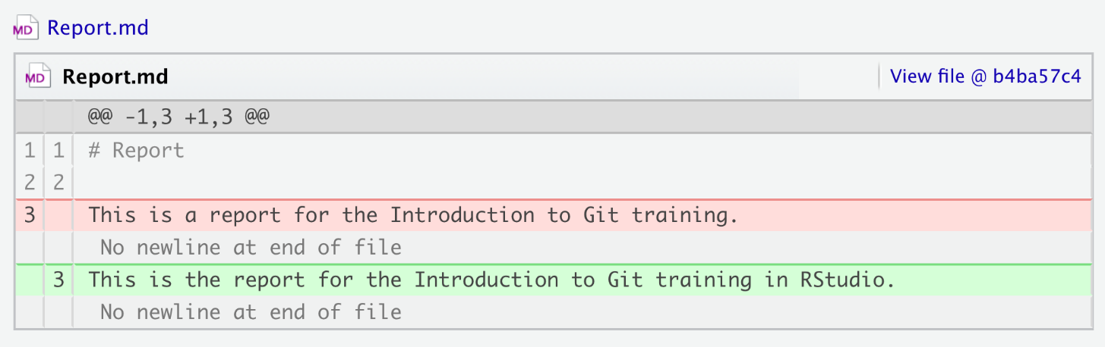
Show
Taking a step into one of the commits, Git allows us to see the specific details and changes that the commit has made.
RStudio’s interface uses colour to highlight the added and deleted components from files.
$ git show <hash>

Slide 33
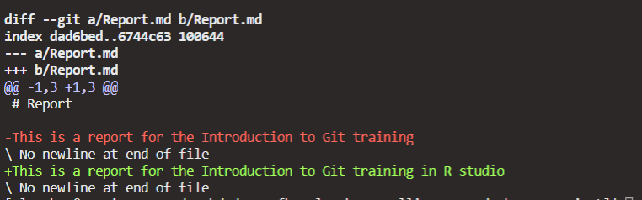
Show – terminal window view example
$ git log -1 Report.md
$ git show 211381617b888d5f0ebc9034fc5856bf97fdb595

Slide 34
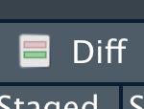
Difference
While you can see the changes one commit has made, you can also compare the difference between any two commits. You’ll see this command come up again.
RStudio doesn’t have an interface for this but the diff will show the difference for all files compared to the last commit.
$ git diff <hash1>..<hash2>
$ git diff <branch>

Slide 35
A Concept Map
files
have
history
make
differences
contains
records
log message
repository
commit
repository
creates
author
Notes:
Note of alt text for this concept map
A repository contains files
An author creates one or more commits
Files have history
When code is committed a log message is recorded with the commit. Commits are records of differences in code.
The history of file is made up of a record of commits of differences to code

Slide 36
Undo
To revert changes to a previous commit, you effectively load the state of the previous commit, and then provide a new commit. This allows a full history where you can make a small undo or even undo your undoing.
$ git checkout <hash> <file|.>
‘file’ – checkout specific filename
‘.’ – checkout full commit for all files
RStudio doesn’t have a user interface for this. However, you can view the history, see what changes were made, copy them to your working files, and then make a commit (if you’d rather avoid the terminal).

Slide 37
Exercise 3
View the repo’s history and find the commit ‘update report’.
Manually undo all changes created by this commit.
Check the status, stage and then commit with a meaningful message.

Slide 38
Branching – the how

Slide 39
Branching
Branches are parallel versions of the repo, allowing simultaneous work. Changes in one branch do not affect others, until merged.
You’ve already been working on a branch, called ‘main’ (‘master’ on old implementations), this is the default primary branch. However, it’s best to protect this branch as “production ready” and develop features in feature branches.
$ git branch
feature-branch
* main

Slide 40
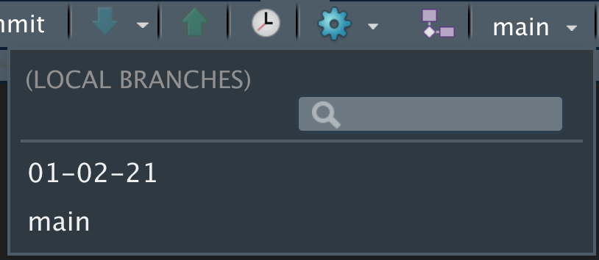
Changing Branches
We’ve seen the checkout command previously; we can use this to switch to an existing branch.
RStudio also provides a dropdown of all existing branches with a search functionality.
$ git checkout <branch>

Slide 41
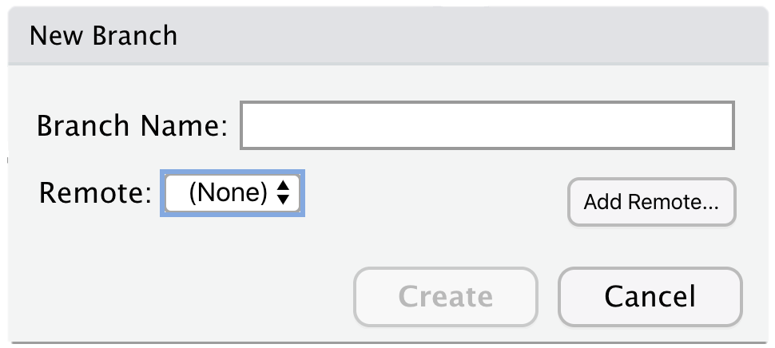

New Branch
When creating a branch, it’s typical to start working on that branch straight away. When we create a branch using these methods, it copies the current branch and switches to the new one.
Branches can’t have spaces, and, in PHS, the workflow is to sometimes create analyst branches (analyst name) rather feature branches.
$ git checkout –b <branch>

Slide 42
A Concept Map
files
have
history
make
differences
contains
consists of
records
branch
commit
log message
repository
repository
creates
author
Notes:
Note of alt text for this concept map
A repository contains files
A repository has many branches
Files are in a branch
A branch consists of one or more commits
An author creates one or more commits
Files have history
When code is committed a log message is recorded with the commit. Commits are records of differences in code.
The history of file is made up of a record of commits of differences to code

Slide 43
Exercise 4
Create a new branch with your name as the branch name.
Add a .txt file with a brief reflection on something you’ve learned/the course does well. Save as Reflection.txt
You guessed it, stage and commit!

Slide 44
Merge
Merging brings the changes from one branch, combining them with another. You should be on the destination branch.
RStudio doesn’t have an interface for this function. So, we need to use the terminal and write some Git commands.
$ git merge <source> <dest>
commit fc75a7ce604a13357f050f0f8735d
Author: Git Learner <learner@git.com>
Date: Mon Feb 01 13:31:26 2021 +0000
initial commit

Slide 45
A Concept Map
files
have
history
make
differences
contains
consists of
records
branch
commit
log message
repository
repository
can merge with
creates
author
Notes:
Note of alt text for this concept map
A repository contains files
A repository has many branches
Files are in a branch
A branch can be merged to one or more times
A branch consists of one or more commits
An author creates one or more commits
Files have history
When code is committed a log message is recorded with the commit. Commits are records of differences in code.
The history of file is made up of a record of commits of differences to code

Slide 46
Conflicts
Conflicts occur when you are merging two branches and there are overlapping changes. Git doesn’t know which version of the code to keep.
Git will add markers inside the file to identify the issue.
<<<<<<< destination-branch-name
...changes from the destination branch...
=======
...changes from the source branch...
>>>>>>> source-branch-name

Slide 47
Resolving Conflicts
Conflicts are resolved by removing the markers, making required changes to the code (keep one change, two or none), then committing those changes. GitHub has an interface for resolving merge conflicts, but Gitea does not.
To avoid conflicts, use branches and agree on scope of work to prevent overlap. The latest version of the main branch should also be merged into your feature branch and any discrepancies fixed before merging feature branches into main.

Slide 48
Deleting Branches
When using branches for features, once they’ve been merged, there’s no longer a need for them. Remember that merging has combined all changes. As such, it’s best practice to delete the branch.
$ git branch –d <branch>

Slide 49
Basic Workflow
1
1+2=3
Main Branch
1+
1+2
1+2=4
1+2=3
Branch
Merge
Commits
Review and discuss
Pull Request
Notes:
Note of alt text for this basic workflow
Branches come off the main branch
An analyst or developer creates a branch from the main code base branch
A branch will usually have two or more commits of changes to code
A pull request is then raised, this will include information on the commits made so far
The pull request is reviewed and discussed
A further commit may happen after discussion
Once the commits in the pull request have been agreed the code is merged back into the main branch

Slide 50



Advanced Workflow
Main
Develop
Bug-fix
Feature
Notes:
Same fundamental building blocks, adding layers which creates benefits.
Note of alt text for this advanced workflow
Branches come off the main branch
An initial branch labelled develop created from the main branch
A further branch is created from the develop branch labelled feature
One of more commits may happen in the feature branch
A pull request is made in the feature branch
The pull request in the feature branch is discussed
After discussion it is merged back into the develop branch
A pull request is made in the develop branch for the code to go back to the main code base
The pull request on the develop branch is discussed
There may be a further commit after discussion
The develop branch is then merged back into the branch
At the same time another analyst or developer may create a branch off the main branch for a bug fix
One or more commits may be made to the bug fix branch
A pull request is made from the bug fix branch
The bug fix pull request is discussed
The bug fix is merged back into the main branch

Slide 51
Remotes – the how

Slide 52
Remotes
Git meets collaboration with remotes. A remote provides a centralized repository that can pulled (downloaded) to your local computer, and then pushed (uploaded) back to the remote. Different services also provide other services to work collaboratively; opening discussions, issues, project planning, etc.
GitHub
Gitea

Slide 53
Check Remotes
The remote command shows the remote names connected (origin is the default), adding –v will print URLs alongside the names.
If you clone a project, Git automatically remembers the remote. It is also possible to have multiple remotes.
$ git remote -v

Slide 54
Add/Delete Remotes
It’s possible to connect any two Git repositories in this way but generally they should share a common history in some way.
$ git remote add <name> <URL>
$ git remote rm <name>

Slide 55
A Concept Map
files
have
history
make
differences
contains
consists of
records
branch
commit
log message
repository
repository
may have
identifies
can merge with
creates
author
remote
Notes:
Note of alt text for this concept map
A repository may have a remote
A remote identifies a repository
A repository contains files
A repository has many branches
Files are in a branch
A branch can be merged to one or more times
A branch consists of one or more commits
An author creates one or more commits
Files have history
When code is committed a log message is recorded with the commit. Commits are records of differences in code.
The history of file is made up of a record of commits of differences to code

Slide 56

Pulling & Pushing
Pulling allows changes made available in the remote repo to be merged with the local copy of the branch. This should be done regularly to make sure updates are received.
Pushing shares changes made locally and committed, back to a remote repo that is hosted on, for example, GitHub.
$ git pull <remote> <branch>
$ git push <remote> <branch>

Slide 57
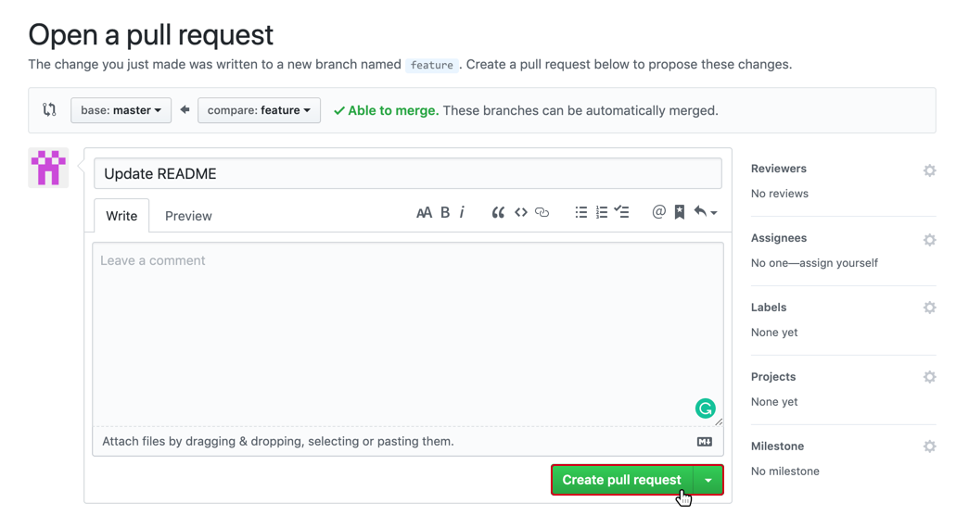
Pull Request
When merging a branch, it’s advised to utilise a pull request. This is like a code review stage and adds some protection to any higher branches. It’s also a great way to learn for the reviewee and reviewer.
The pull request must be generated from the remote.

Slide 58


Pull Request: How-To
On GitHub, go to ‘Pull requests’ tab and click ‘New’.
Select the branch you're merging to as ‘base’ and the feature branch as ‘compare’.
Add a title and comments.
Further options are available on the right menu, e.g., adding specific reviewers.

Slide 59
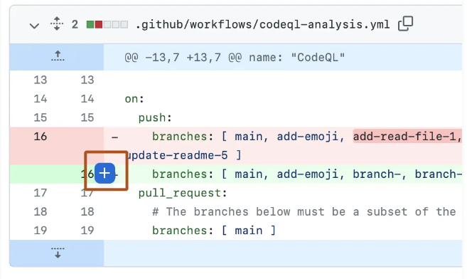
Code Review – How to
You can review code and add comments in GitHub and Gitea.
Pull requests > Select PR
In the Files Changed tab, you can add comments to specific lines. You can also add a general comment and “Approve” or “Request changes” for the overall PR.

Slide 60
Exercise 5
Check your remotes, `git remote -v`, you should still be connected to the original GitHub remote.
Push the changes from your named branch.
Open a pull request on GitHub to merge your named branch with today’s dated branch. Add another trainee as the reviewer.

Slide 61
Remotes - Tips
When creating a new branch, ensure you’re on the branch you want to branch from (usually main) and pull it to get the latest changes from the remote.
Keep commits small and targeted, with useful messages.
Pull from the remote regularly, especially when collaborating, to keep local files up to date.
Communicate with your team to avoid merge conflicts.

Slide 62
Activity
Go to GitHub repo: github.com/Public-Health-Scotland/learn-git
Guided code review of pull requests
Handle a git conflict.
Notes:
github.com/Public-Health-Scotland/learn-git

Slide 63
Using Git in your team
Main folder
When using Git in your team, it is good practice for each analyst to have their own folder and clone of the repository.
Depending on your team’s folder structure, you can have analyst folders in each work folder (image) or one analyst folder with multiple git repo’s in.
Avoid having Data and Output folders in the repo folder, but still include data files in your gitignore file to be safe.
Analyst 1
Analyst 2
Data
Output
git_repo
git_repo
Notes:
Image of main folder which contains two analyst folders with git repo folders, one Data folder and one Output folder.

Slide 64
Review

Slide 65
A Concept Map - review
files
have
history
make
differences
contains
has many
consists of
records
branch
commit
log message
repository
may have
identifies
can merge with
creates
author
remote
Notes:
Note of alt text for this concept map
A repository may have a remote
A remote identifies a repository
A repository contains files
A repository has many branches
Files are in a branch
A branch can be merged to one or more times
A branch consists of one or more commits
An author creates one or more commits
Files have history
When code is committed a log message is recorded with the commit. Commits are records of differences in code.
The history of file is made up of a record of commits of differences to code

Slide 66





Git System
git add
git commit
edits
Developer
Working Directory
Staging Area
Local Repo
git pull
git push
Remote Repo
Notes:
Create repo $ git init
Create or select branch $ git checkout –b <name of new feature branch> or $ git checkout
Write code
Stage code $ git add
Commit changes $ git commit
Push changes $ git push
Create a pull request in Github or Gitea
Merge branches $ git merge

Slide 67
Advanced Workflow - review
Main
Develop
Bug-fix
Feature
Notes:
Same fundamental building blocks, adding layers which creates benefits.
Note of alt text for this advanced workflow
Branches come off the main branch
An initial branch labelled develop created from the main branch
A further branch is created from the develop branch labelled feature
One of more commits may happen in the feature branch
A pull request is made in the feature branch
The pull request in the feature branch is discussed
After discussion it is merged back into the develop branch
A pull request is made in the develop branch for the code to go back to the main code base
The pull request on the develop branch is discussed
There may be a further commit after discussion
The develop branch is then merged back into the branch
At the same time another analyst or developer may create a branch off the main branch for a bug fix
One or more commits may be made to the bug fix branch
A pull request is made from the bug fix branch
The bug fix pull request is discussed
The bug fix is merged back into the main branch

Slide 68

Knowledge Check
It’s time for a quiz! You’ll receive a link or you can click below if you’re using the slides.
You will receive immediate feedback but we’ll come back in 10 mins to review.
Start Quiz

Slide 69

Getting Help
PHS Quick Guide to Git & GitHub
Google / Stack Overflow
tag queries "[git]" & "[github]"
PHS Data and Intelligence Forum – Github and Gitea Queries

Slide 70
Course feedback
Please take a few minutes to complete the course feedback form
PHS Introduction to Git Training - Feedback Form (office.com)

